Slide 1
Introduction to Machine Learning

Slide 2
Outline
Applications of Machine Learning
What is Machine Learning?
How Machine Learning works?
Traditional Programming vs Machine Learning

Slide 3

Social Media
Social media platforms notices and records your activities, chats, likes, and comments, and the time you spend on specific kinds of posts. Machine learning learns from your own experience and makes friends and page suggestions for your profile.

Slide 4


Product Recommendation
Using machine learning, websites track your behavior based on your previous purchases, searching patterns, and cart history, and then make product recommendations.

Slide 5


Content Recommendation
Using machine learning, video streaming platforms track your behavior based on your previous videos watched, searching patterns history, and then make suggested video recommendations.

Slide 6

Image Recognition
An approach for cataloging and detecting a feature or an object in the digital image, is one of the most significant and notable machine learning techniques. This technique is being adopted for further analysis, such as pattern recognition, face detection, object detection and face recognition.

Slide 7

Language Translation
One of the most common machine learning applications is language translation. The technology behind the translation tool is called machine translation.

Slide 8
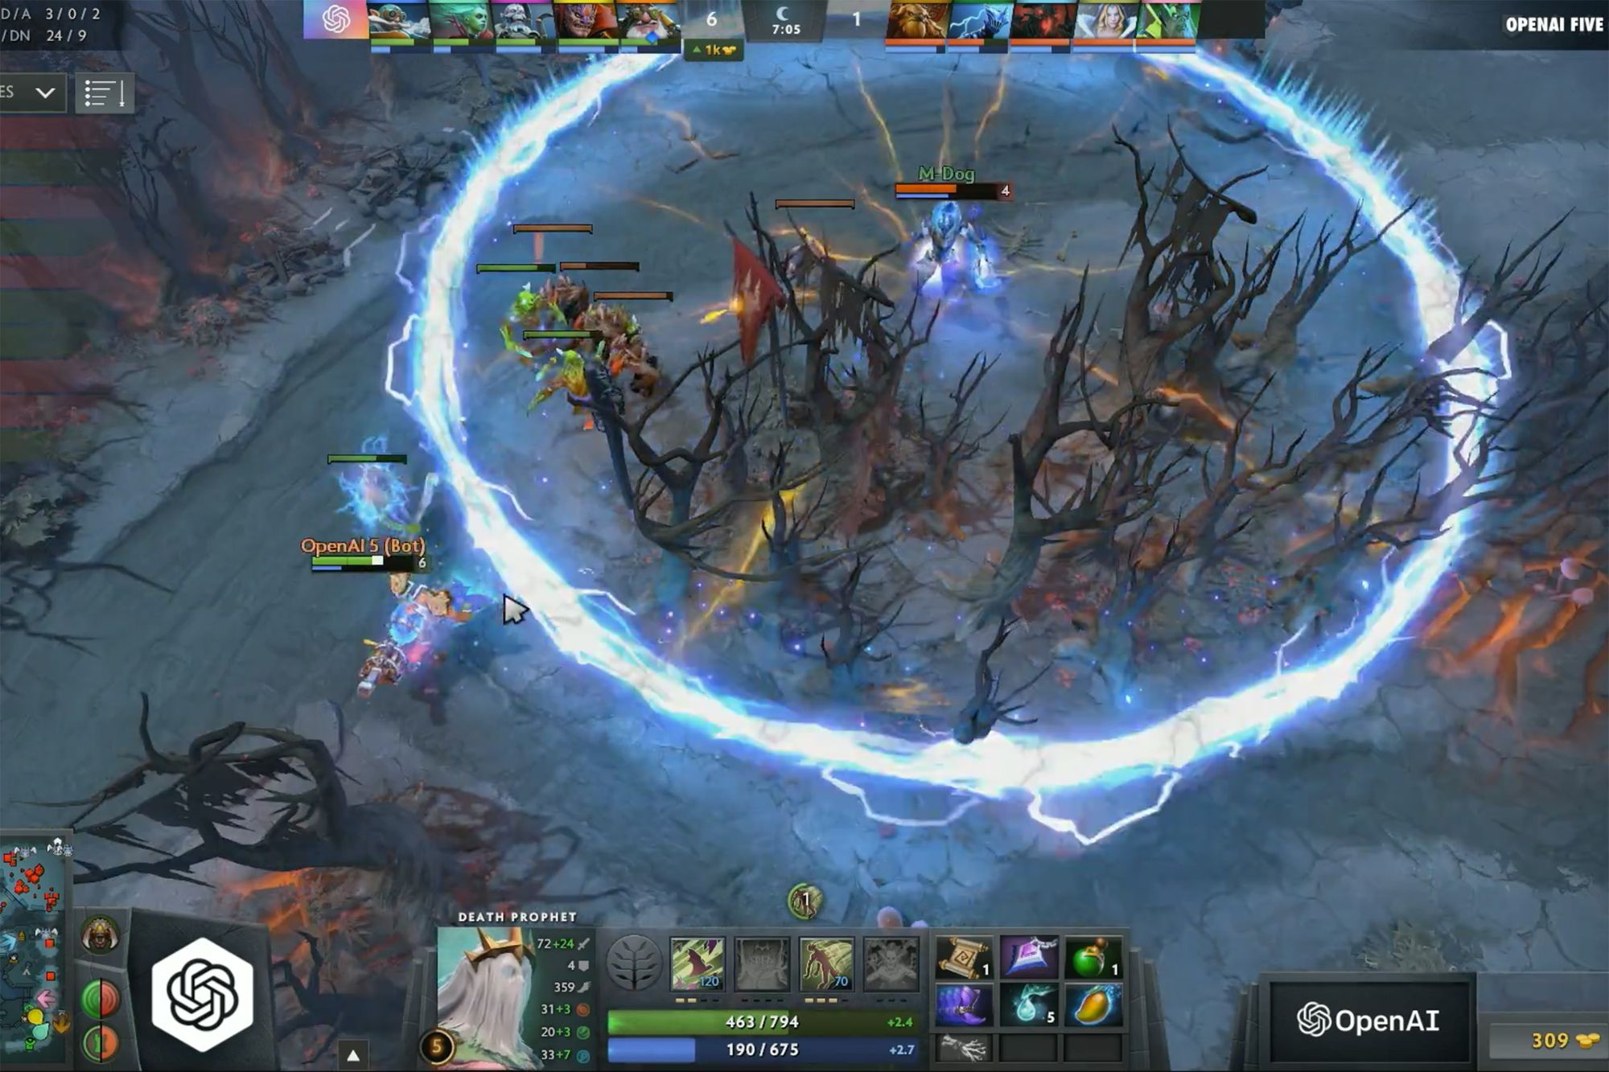
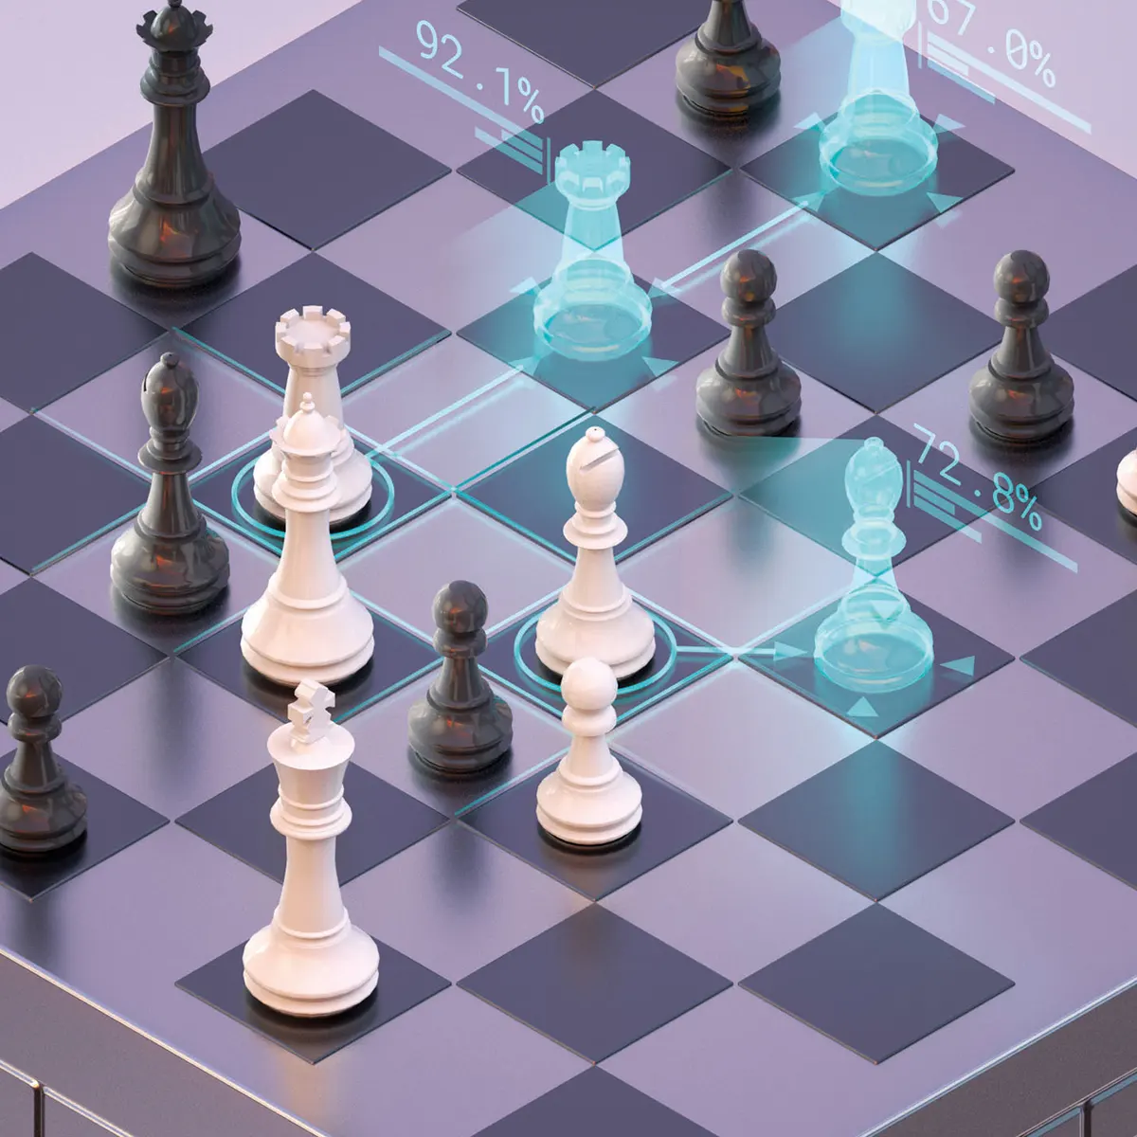
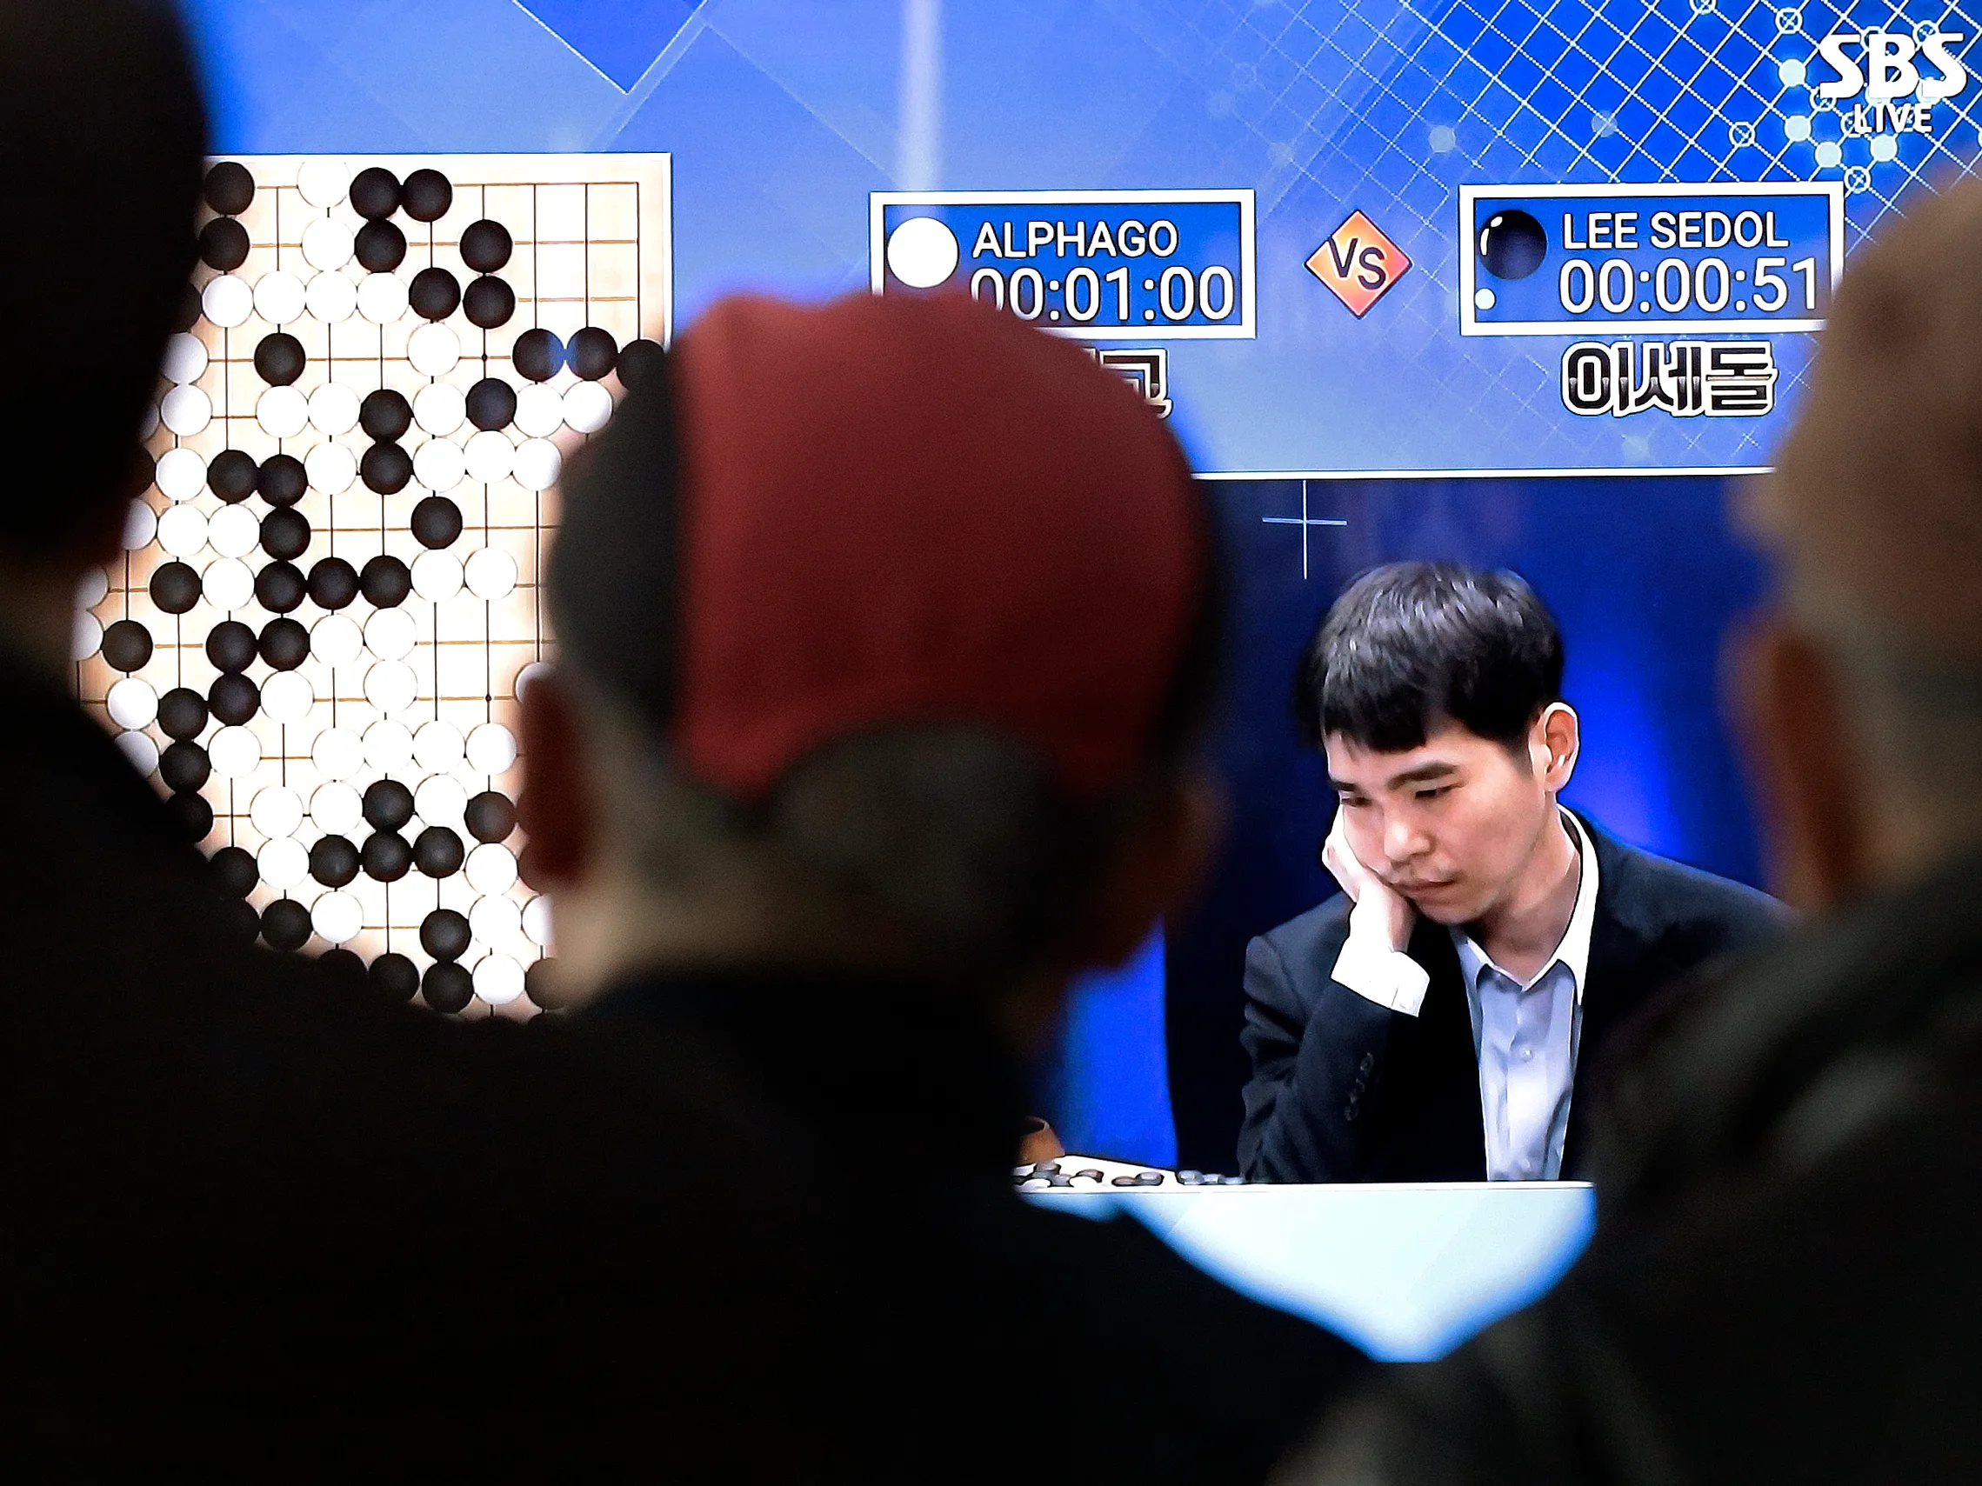
AI Players
Machine learning led to the creation of powerful programs such as Open AI Five, AlphaZero, AlphaGo. They have achieved superhuman performance and have become invaluable tools for analyzing and learning from games.

Slide 9
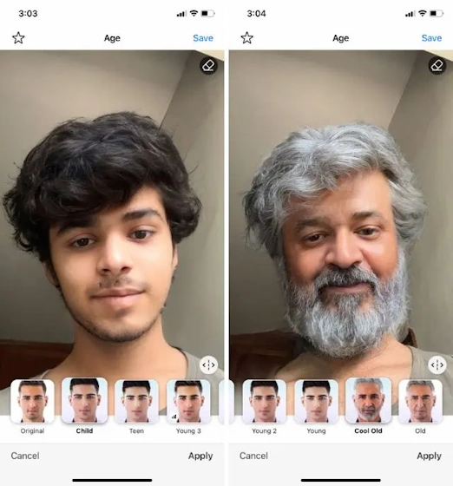

Synthesizing images

Slide 10


Generating Text

Slide 11
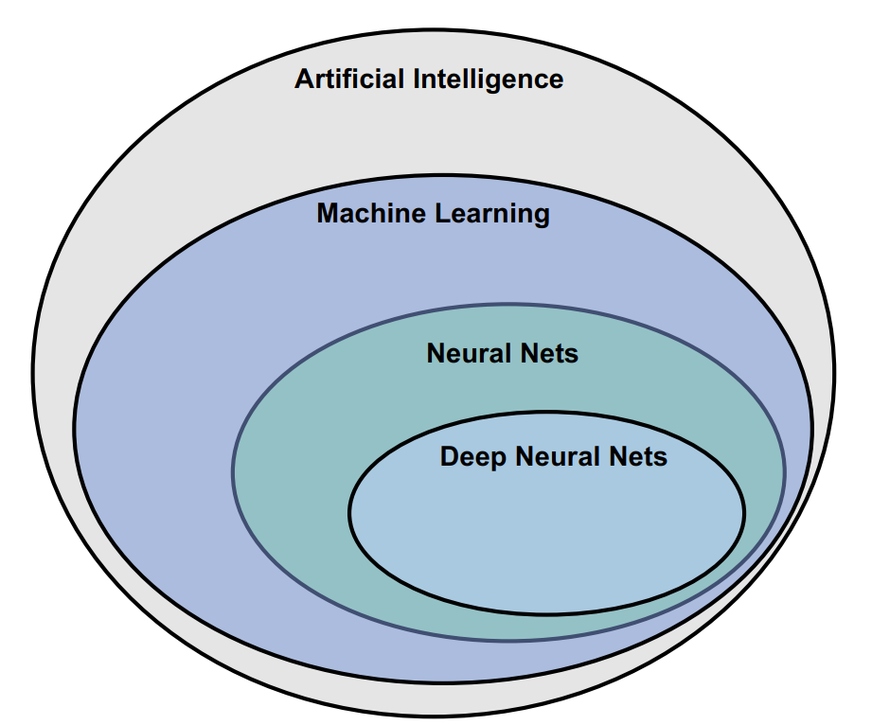
What is Machine Learning?
Artificial Intelligence (AI) refers to the simulation of human intelligence in machines or any technique that enables computers to mimic human behavior.
One of those techniques is Machine Learning!

Slide 12
To understand what machine learning is,
we need to learn how to think like one!

Slide 13
Input | 1 | 2 | 3 | 4
Output | 2 | 4 | 6 | 8

Slide 14
Input | 1 | 2 | 3 | 4 | 5
Output | 2 | 4 | 6 | 8 | ???
Question: What will be the output value if we have an input value of 5?

Slide 15
Input | 1 | 2 | 3 | 4 | 5
Output | 2 | 4 | 6 | 8 | 10
Output = Input * 2
f(x) = x * 2

Slide 16
Input | 0 | 8 | 15 | 22
Output | 32 | 46.4 | 59 | 71.6

Slide 17
Input | 0 | 8 | 15 | 22 | 38
Output | 32 | 46.4 | 59 | 71.6 | ???
Question: What will be the output if we have an input value of 38?

Slide 18
Input | 0 | 8 | 15 | 22 | 38
Output | 32 | 46.4 | 59 | 71.6 | 100.4
Output = Input * 1.8+32
f(x) = x * 1.8+32

Slide 19

What you just did to figure out the relation between inputs and outputs is exactly what machine learning does!

Slide 20
Given a set of inputs and their corresponding outputs, the goal in machine learning is to figure out the algorithm to convert the inputs to the outputs!
We learn through data!

Slide 21

Algorithm
Traditional Programming
Output
Input
The input and algorithm is known and you write a function to produce an output

Slide 22
Input
Machine Learning
Algorithm
Output
You know the input and the output but you do not know the algorithm that creates the output given the input

Slide 23
Algorithm
Traditional Programming
Output
Input
Input
Machine Learning
Algorithm
Output

Slide 24
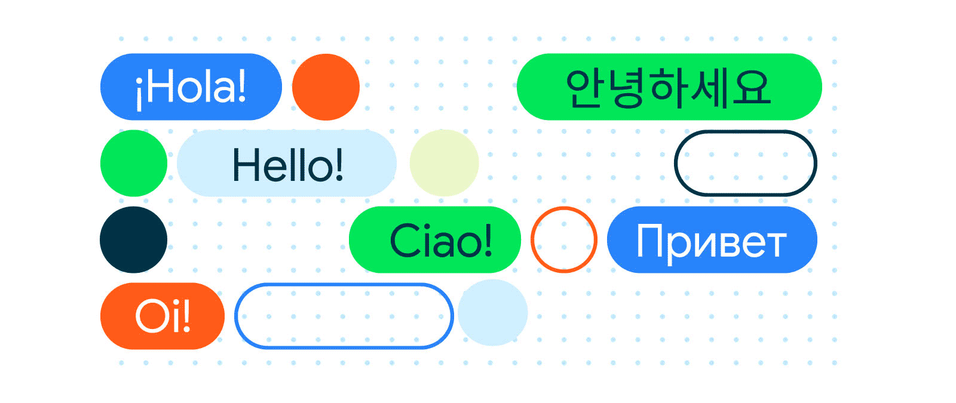
Limits of Traditional Programming
Tasks such as Language Translation and Understanding cannot be solved using traditional programming.

Slide 25
def translate_to_english (word):
if word == "House":
translated = "Bahay”
else:
...
...
...
return translated
Creating an if statement for every word in a vocabulary is very tedious and inefficient.

Slide 26
def function (Celsius):
Fahrenheit = Celsius * 1.8 + 32
return Fahrenheit
Input
Algorithm
In traditional programming, we only know the Input and the Algorithm.

Slide 27
def function (Celsius):
????
return Fahrenheit
Input
In ML, we only know the Input and Output
Output

Slide 28
def function (Celsius):
return Fahrenheit
Input
Machine Learning Algorithm
Output

Slide 29
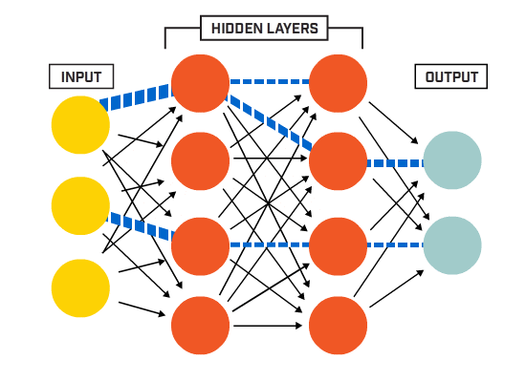
The Machine Learning Approach
A machine learning approach consists of using machine learning algorithm like a neural network to learn the relations between the inputs and the outputs, thus learning the algorithm
Machine Learning Algorithm

Slide 30
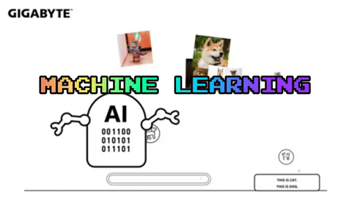
The Machine Learning Approach
In order for a machine learning algorithm to learn the correct relationship between the inputs the and outputs, we have to train it!

Slide 31
The Machine Learning Approach
Input | 0 | 8 | 15 | 22 | 38
Output | 32 | 46.4 | 59 | 71.6 | 100.4
We train our machine learning algorithm by letting it try to map the inputs to the outputs.

Slide 32
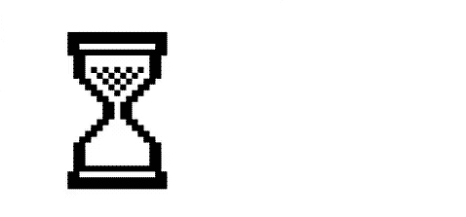
def function (Celsius):
return Fahrenheit
The time it takes to train a machine learning algorithm depends on the size of our data!
Machine Learning Algorithm

Slide 33
The Machine Learning Approach
In other words, you can think of a machine learning algorithm as a function that can tune its variables in order to correctly map its inputs to some outputs.
Machine Learning Algorithm

Slide 34
The Machine Learning Approach
As we will see throughout this course, the training process to teach our machine learning algorithm to tune its internal variables is performed for thousand or even millions of iterations over the input and output data!
Machine Learning Algorithm

